Slide 1
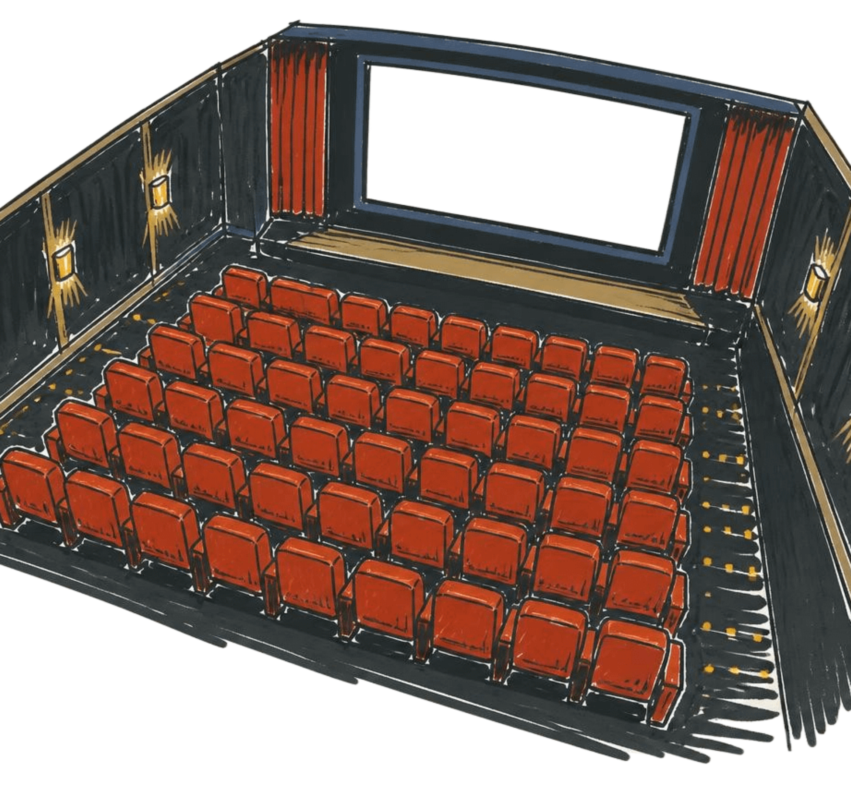

Capstone Project
Cinema Seat Booking System
Vayyala Dhikshitha - 2620030310
Rishvika Reddy - 2620080099
Section - 2

Slide 2
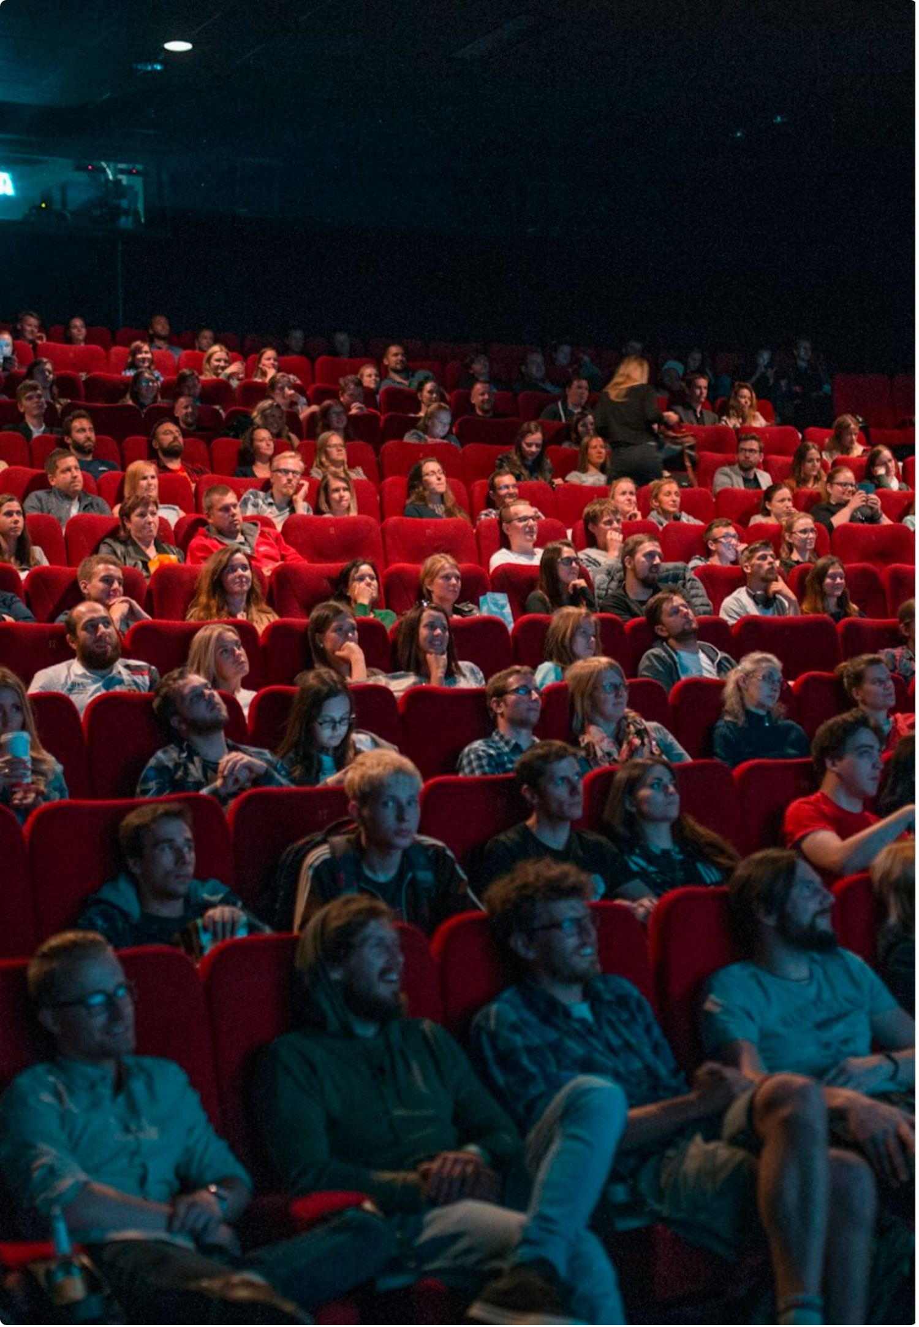




JAVA
ABSTRACT
View
From paper booking to a live console view
See the current 2D layout.
This console-based Java mini-project replaces manual, paper-based cinema booking. Users can view the live seat layout, check availability, book seats, and cancel bookings. Available seats appear as [0]; booked seats appear as [1]. Instant status updates prevent double booking, while automated pricing and receipts remove manual calculation.
Book
Reserve an available seat.
Cancel
Release the seat immediately.
Pay
Calculate price and print a receipt.
Notes:
Explain the practical shift: instead of checking a paper list, the user sees the current state of every seat. The same system handles the booking decision, protects availability, calculates the amount, and confirms the transaction with a receipt.

Slide 3

FLOW
HOW IT WORKS + NEXT
From seat choice to a stronger Java system
01
02
03
04
05
View
Select
Book
Pay
Cancel
Show the 2D seat layout.
Validate availability.
Update seat and history.
Price ticket; print receipt.
Release and refresh.
Loading...
Core Java
Future scope
Classes + objects model bookings. Conditions + loops validate input. Arrays + ArrayLists hold layout and history. Switch drives the menu.
Next: group booking, tiered pricing, seat recommendations, and multiple movies with show timings.
Notes:
Close by connecting the workflow to the Java concepts behind it. The user views the layout, selects a seat, validates availability, books, pays, and can cancel to release the seat. Classes and objects model the booking entities, data structures hold the state, and switch statements make the console easy to navigate. The next version can add smarter booking rules, richer pricing, recommendations, and multiple shows.

